Slide 1
E-Commerce Customer Segmentation
Trend Analysis & Insights
Understanding customer behavior patterns and sales performance to drive strategic growth initiatives

Slide 2
Objective & Problem Statement Business goals and analytical framework overview
Performance Overview Key metrics and Trend Analysis
Customer Insights RFM analysis and segmentation finding
Strategic Recommendations Actionable insights for growth optimization
01.
02.
03.
04.

Slide 3
Project Objectives
Performance Tracking/ Trend Analysis
Identify high-value customers and segment by recency, frequency, and monetary value using RFM methodology
Customer Insights After analysis
Identify high-value customers and segment by recency, frequency, and monetary value using RFM methodology
$8.30M
$374.05
98.19%
4,372
Total Customers
Repeat Rate
Total Sales
Average AOV
Sales Performance
Customer Loyalty
Growth Opportunities
Strong revenue generation with healthy customer base and robust average order values
Exceptional repeat purchase behavior indicating strong customer satisfaction and brand loyalty
Regional expansion potential and customer value optimization strategies for sustained growth
Total revenue of $8.30M demonstrates market strength
98.19% repeat order rate shows outstanding customer retention
Europe dominance suggests expansion opportunities in other regions
Customer base of 4,372 provides substantial market reach
High loyalty reduces customer acquisition costs significantly
RFM segmentation reveals untapped customer value potential
AOV of $374.05 indicates premium customer purchasing behavior
Strong foundation for long-term revenue growth projections
Return rate optimization can improve profitability margins

Slide 4
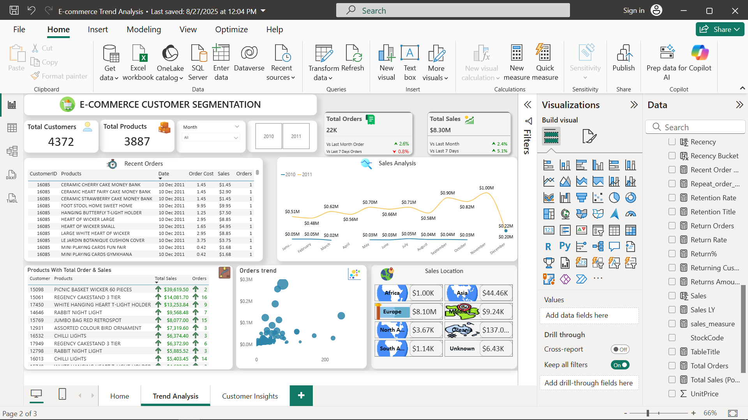
$8.30M
4,372
$374.05
98.19%
Total Sales
Total Customers
Average AOV
Repeat Rate
Sales Performance
Customer Loyalty
Growth Opportunities
Strong revenue generation with healthy customer base and robust average order values
Exceptional repeat purchase behavior indicating strong customer satisfaction and brand loyalty
Regional expansion potential and customer value optimization strategies for sustained growth
Total revenue of $8.30M demonstrates market strength
98.19% repeat order rate shows outstanding customer retention
Europe dominance suggests expansion opportunities in other regions
Customer base of 4,372 provides substantial market reach
High loyalty reduces customer acquisition costs significantly
RFM segmentation reveals untapped customer value potential
AOV of $374.05 indicates premium customer purchasing behavior
Strong foundation for long-term revenue growth projections
Return rate optimization can improve profitability margins
Trend Analysis
Seasonality Drives Sales: Strong surge in November (holiday season), followed by a December dip.
High-Value Product Focus: A few decor/home products dominate sales, suggesting the need to expand best-selling categories.
Regional Imbalance: Europe accounts for nearly all sales, while other geographies remain untapped opportunities.
Revenue per Order Increasing: Sales % growth is higher than order % growth → customers are spending more per purchase.
Customer Segmentation Required: Bubble chart shows clear whale customers (high spenders) vs long tail of small buyers.
Key Trends

Slide 5

Trend Analysis
Seasonality Drives Sales: Strong surge in November (holiday season), followed by a December dip.
High-Value Product Focus: A few decor/home products dominate sales, suggesting the need to expand best-selling categories.
Regional Imbalance: Europe accounts for nearly all sales, while other geographies remain untapped opportunities.
Revenue per Order Increasing: Sales % growth is higher than order % growth → customers are spending more per purchase.
Customer Segmentation Required: Bubble chart shows clear whale customers (high spenders) vs long tail of small buyers.
Key Trends

Slide 6
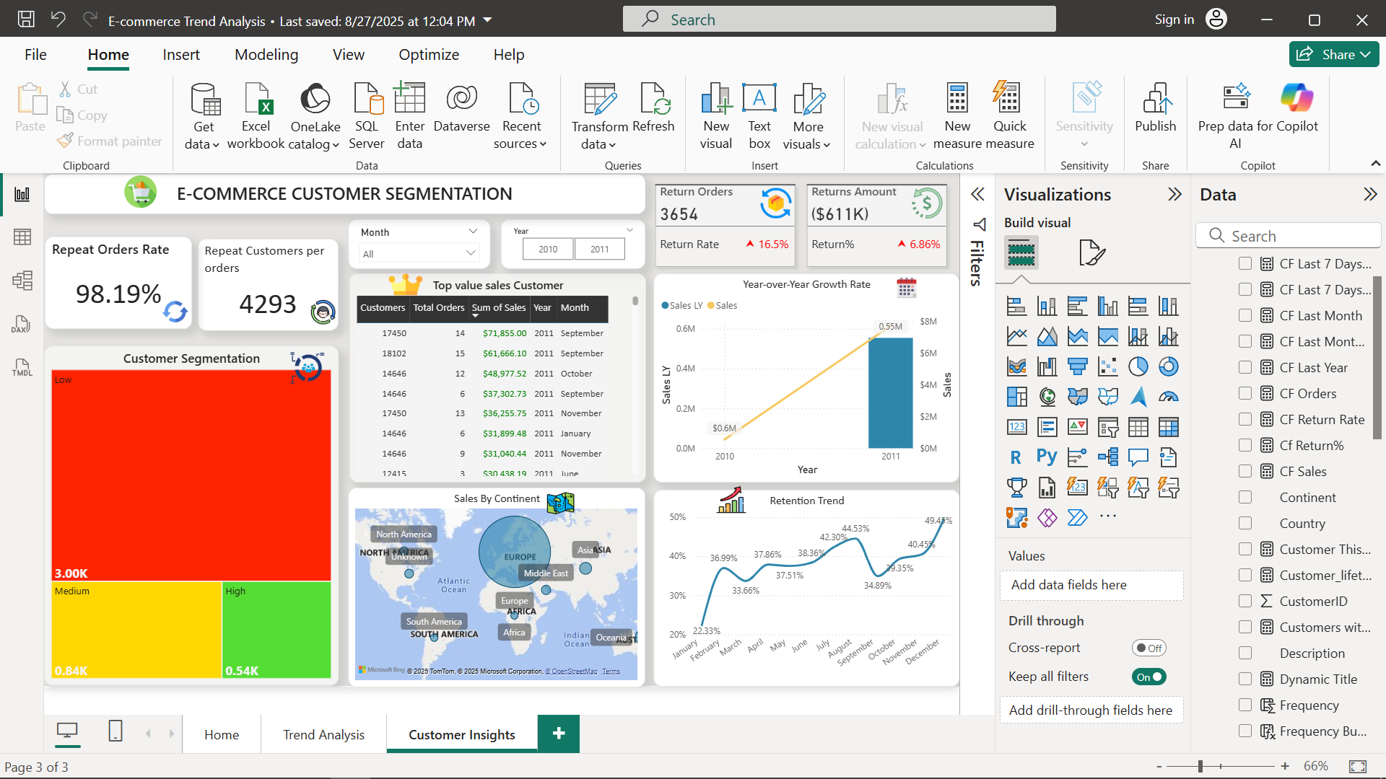
Performance Insights
Customer & Products Overview
4,372 customers and 3,887 products tracked.
22K total orders, generating $8.30M total sales.
Growth & Trends
Sales improved by 2.4% vs last month and 5.1% vs last 7 days.
Monthly sales trend shows steady growth from Jan ($0.05M) to Dec ($1M peak).
Top Products & Customers
High-value products: Picnic Basket Wicker ($39.6K), Regency Cake Stand ($14K), White Hanging Heart T-Light Holder ($13.2K).
Sales are product-driven, with a few items generating the bulk of revenue.
Geographic Sales Distribution
Europe dominates with $8.1M (~98% of total sales).
Other regions contribute marginally: Asia ($44K), North America ($3.7K), Africa ($1K), South America ($1.1K).
Order Behavior
Orders trend analysis shows many small-value orders but a few large, high-value orders drive major revenue.
Long-tail distribution highlights opportunity to upsell low-order customers.
Customer Insights
Strong Loyalty but Skewed Value: Nearly all orders are from repeat customers, but majority are low-value buyers → high potential for customer up-selling/cross-selling.
High Return Rate (16.5%): Significant profit leakage; root cause analysis (product quality, logistics, customer mismatch) is needed.
Explosive Growth (10x YoY): Indicates successful scaling, But requires careful monitoring of returns & retention.
Heavy Reliance on Europe: 98%+ sales in Europe → expansion into Asia & North America could reduce risk.
Retention Improving: Gradual increase throughout the year suggests effective loyalty strategies are working.
Whale Customers Drive Revenue: A few top customers account for large sales → business must ensure long-term retention of high-value customers.
Key Trends

Slide 7
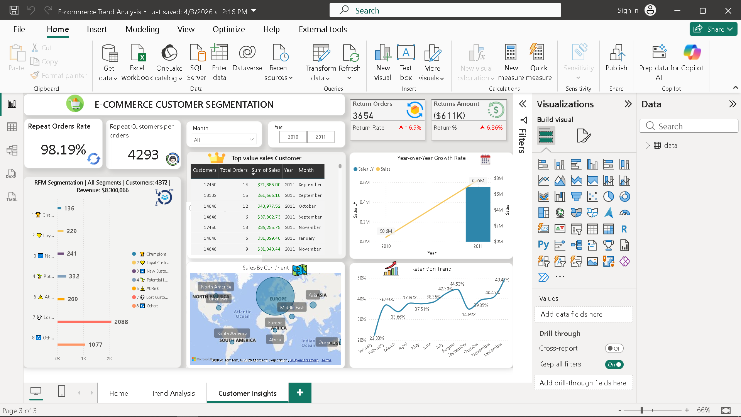
Customer Insights
Strong Loyalty but Skewed Value: Nearly all orders are from repeat customers, but majority are low-value buyers → high potential for customer up-selling/cross-selling.
High Return Rate (16.5%): Significant profit leakage; root cause analysis (product quality, logistics, customer mismatch) is needed.
Explosive Growth (10x YoY): Indicates successful scaling, But requires careful monitoring of returns & retention.
Heavy Reliance on Europe: 98%+ sales in Europe → expansion into Asia & North America could reduce risk.
Retention Improving: Gradual increase throughout the year suggests effective loyalty strategies are working.
Whale Customers Drive Revenue: A few top customers account for large sales → business must ensure long-term retention of high-value customers.
Key Trends

Slide 8
Performance Insights
Strong Repeat Orders Rate of 98.19%, showing high customer loyalty.
4,293 repeat customers → healthy base of returning buyers.
Return Orders (3,654) and Return Amount ($611K) → 16.5% return rate, a key area to reduce losses.
Top customers drive majority of sales – one customer contributed $71.8K.
Sales Growth: From $0.6M in 2010 to $6M+ in 2011 (10x growth).
Retention improved steadily → peaked at 49.4% in December.
Sales concentrated in Europe (~98%) → dependency risk, expansion to other continents is an opportunity.
Indicates most customers contribute low sales, but strong potential to move Medium → High value with targeted strategies.
Year-over-Year Growth confirms rapid scaling and successful expansion.

Slide 9


Challenges vs Strategic Solutions
Current Challenges
Strategic Solutions
High return rate of 16.5% affecting profitability margins
Implement quality control and delivery experience improvements
Inconsistent retention rates across monthly periods
Implement quality control and delivery experience improvements
V/S
Regional concentration risk with Europe dependency issues
Implement quality control and delivery experience improvements
Strategic Implementation
Customer Focus
1
Nurture high-value customers with targeted loyalty and retention programs
Customer Focus
2
Nurture high-value customers with targeted loyalty and retention programs
Customer Focus
3
Nurture high-value customers with targeted loyalty and retention programs
Customer Focus
4
Nurture high-value customers with targeted loyalty and retention programs
Customer Focus
5
Nurture high-value customers with targeted loyalty and retention programs

Slide 10
Strategic Implementation
Customer Focus
1
Nurture high-value customers with targeted loyalty and retention programs
Quality Enhancement
Address return rates through improved quality control and delivery
2
Market Expansion
3
Reduce European dependency through Asia and Americas expansion
Optimization
4
Leverage RFM insights for personalized customer experiences
Performance Monitoring
5
Track retention metrics and adjust strategies continuously

Slide 11
Thank You
Questions and discussion on customer segmentation insights
Ready to implement data-driven strategies for enhanced customer loyalty and business growth

